Slide 1


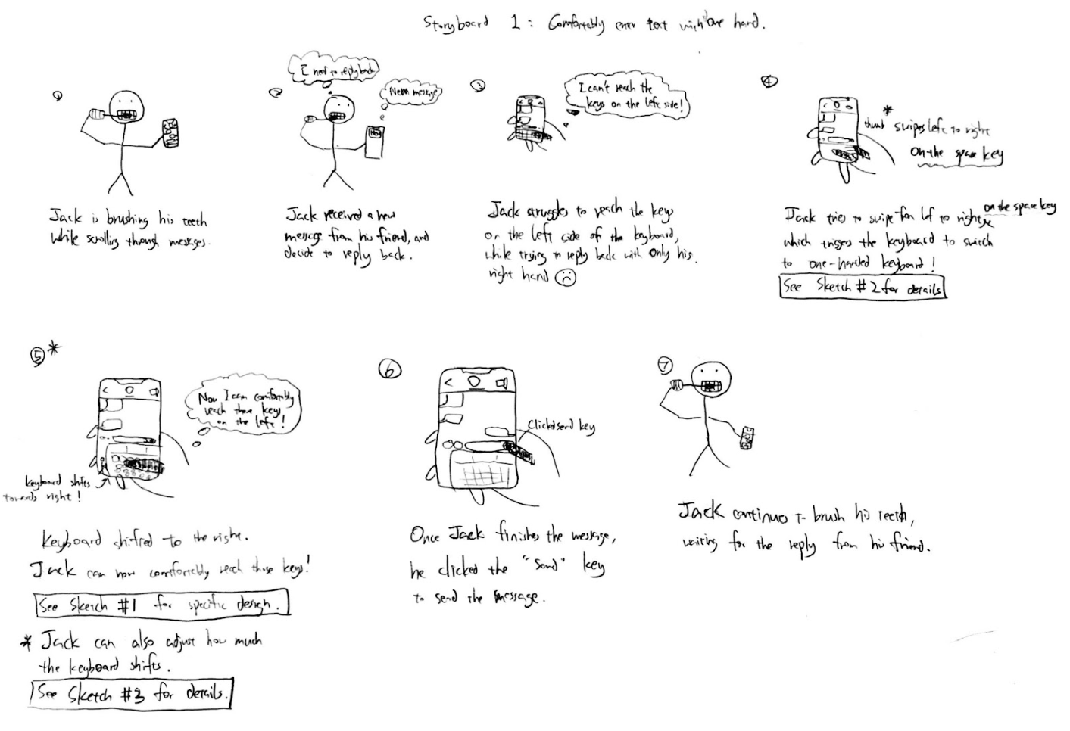
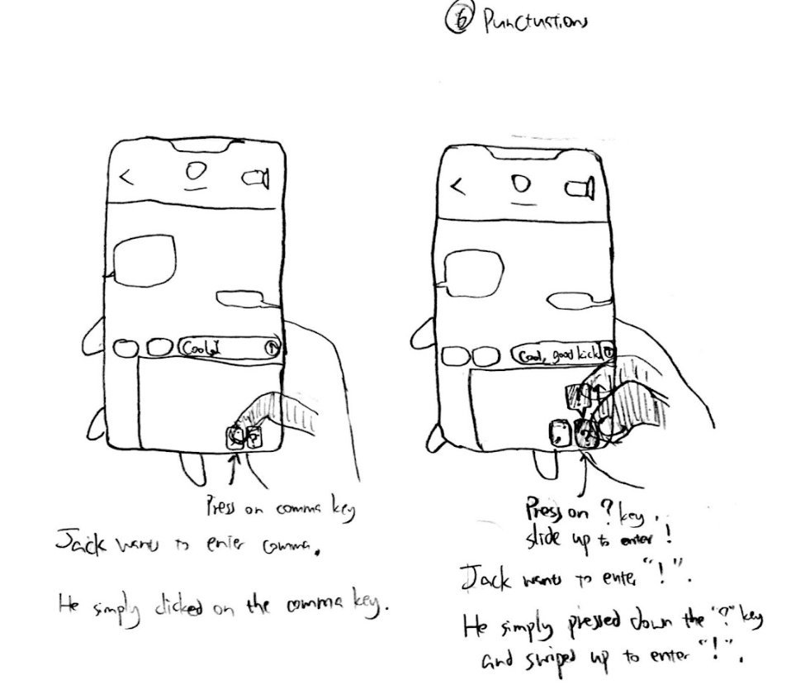
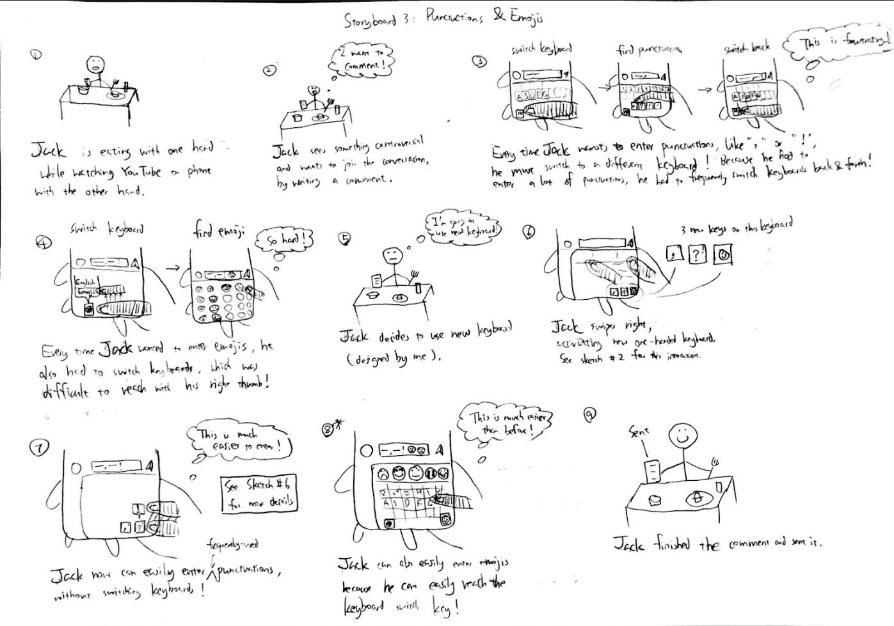
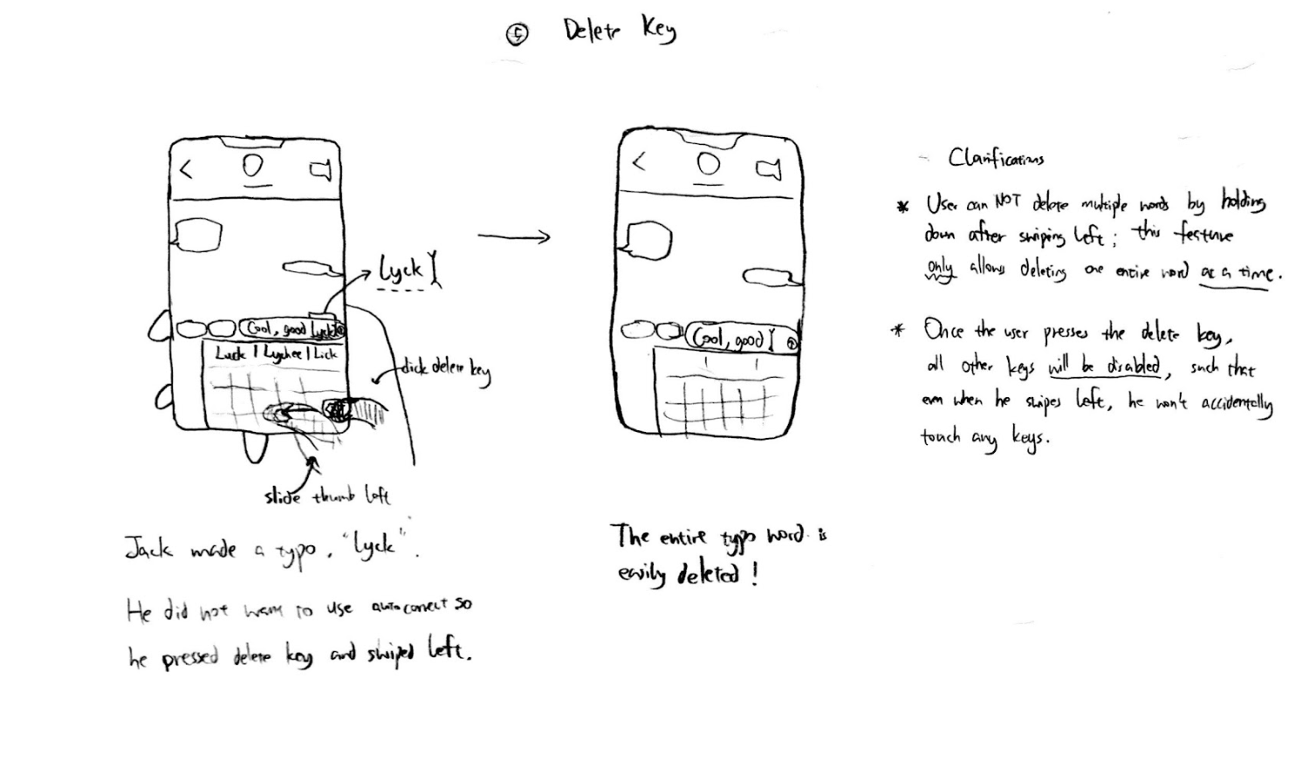
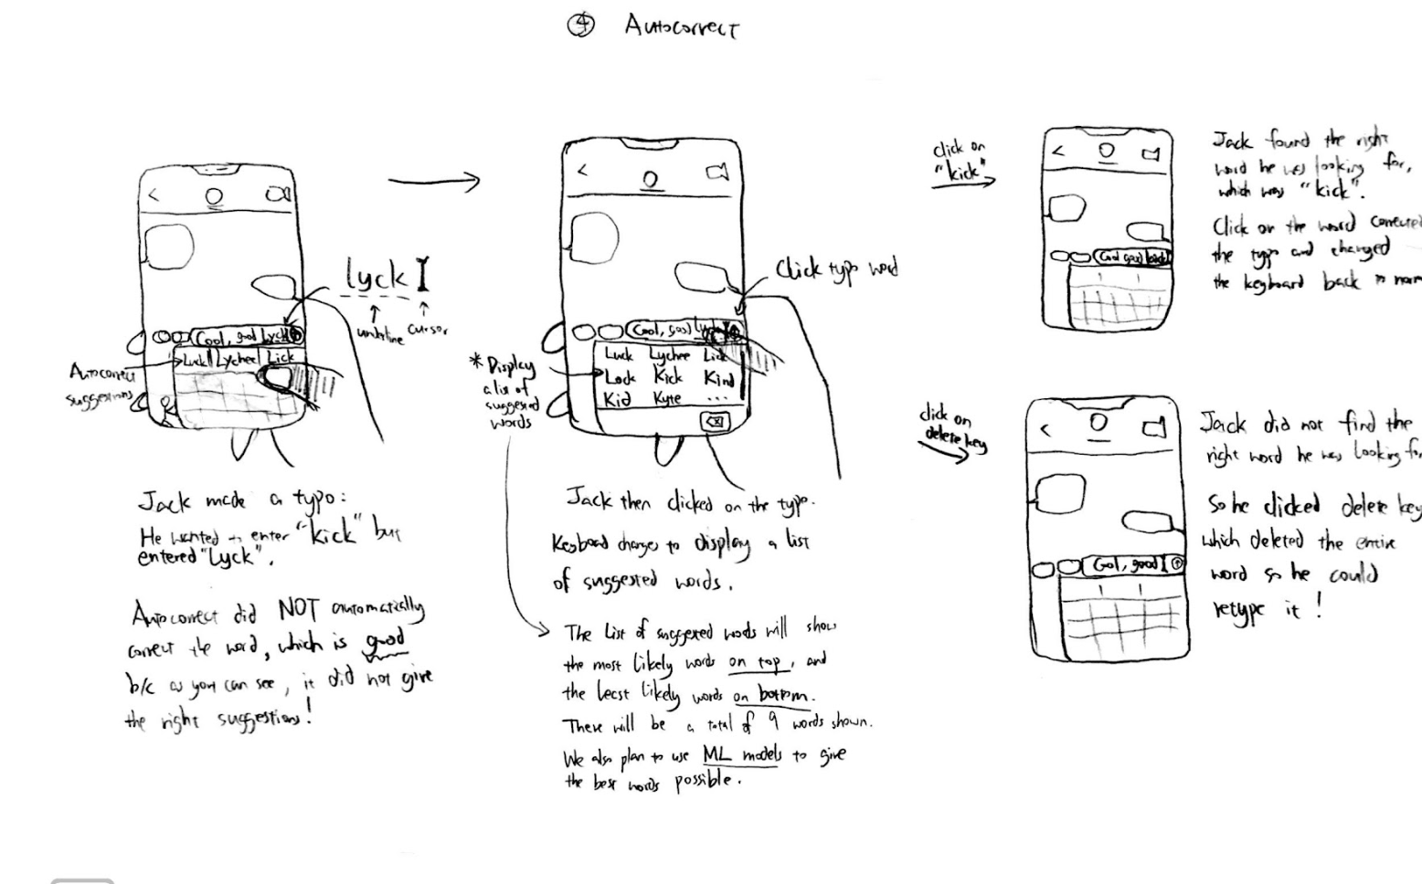
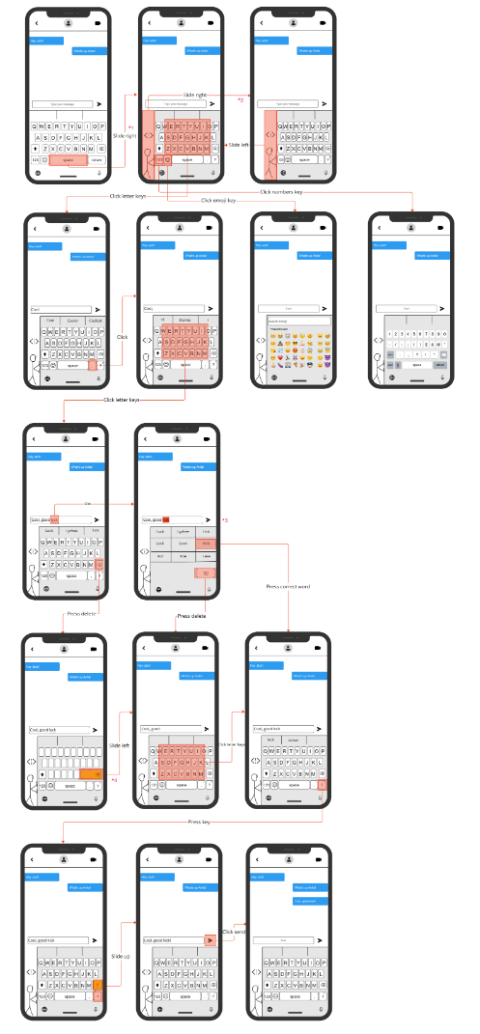
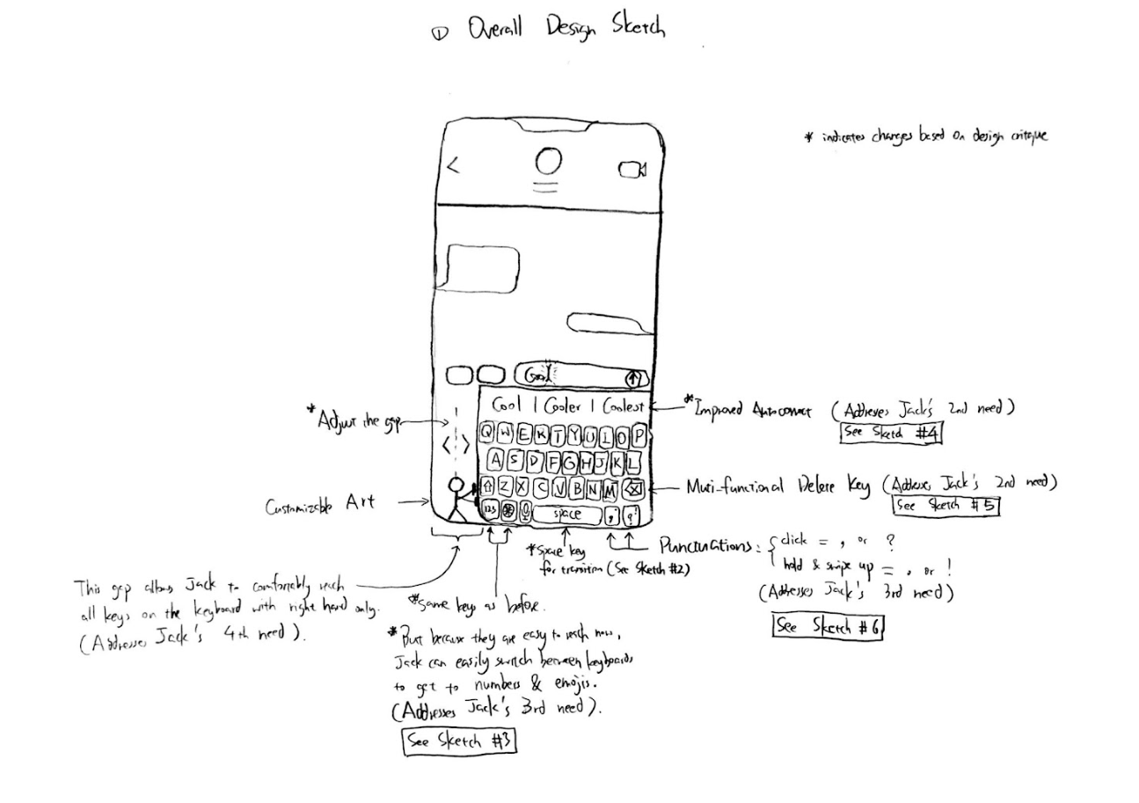
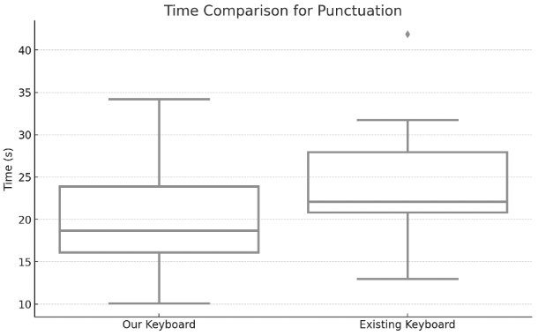
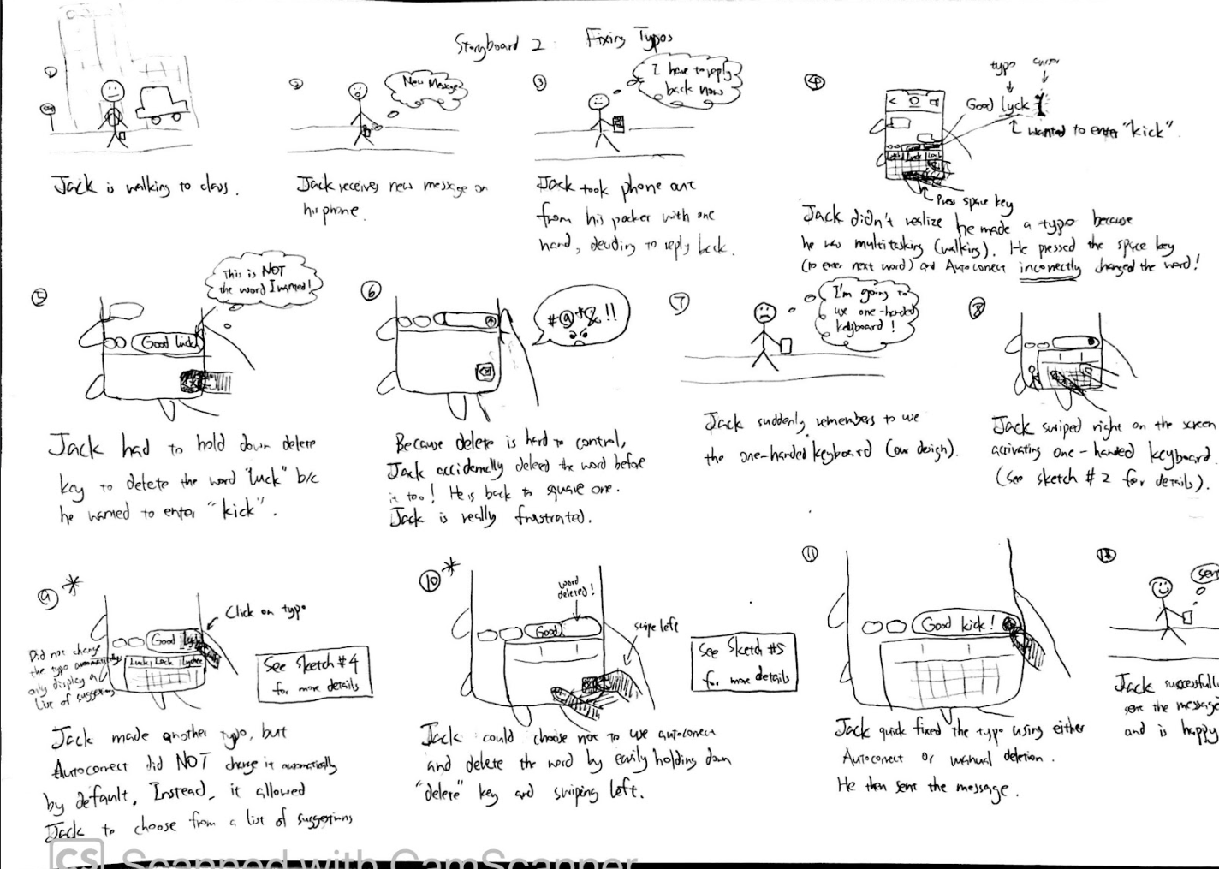
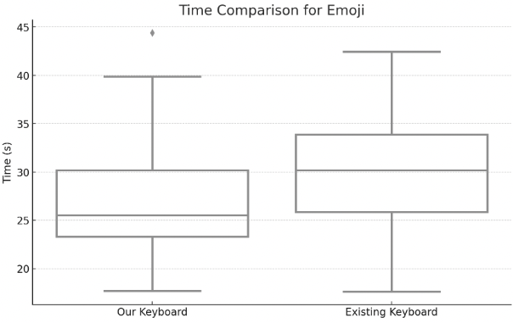
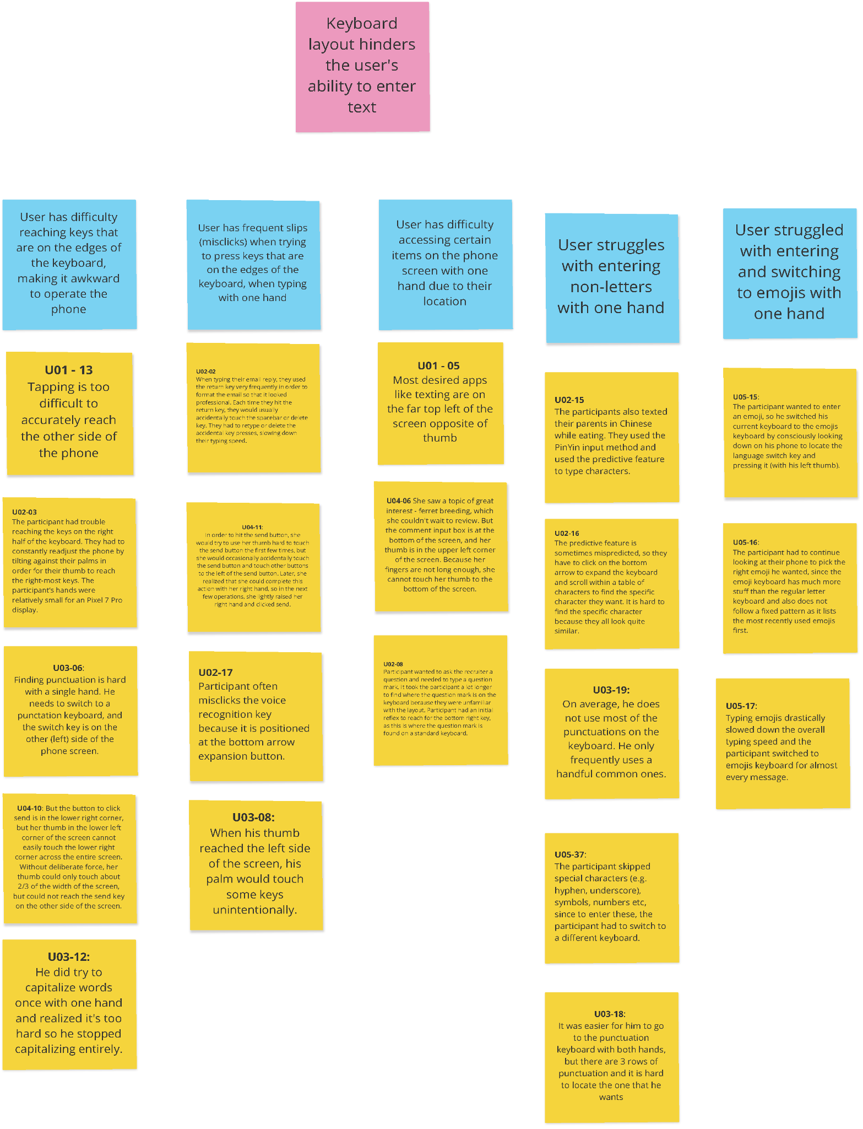
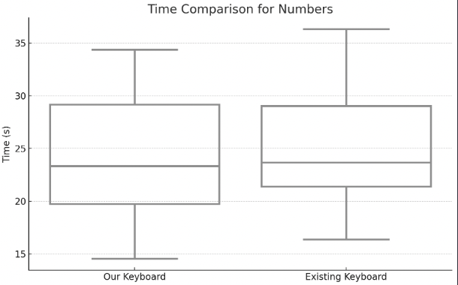
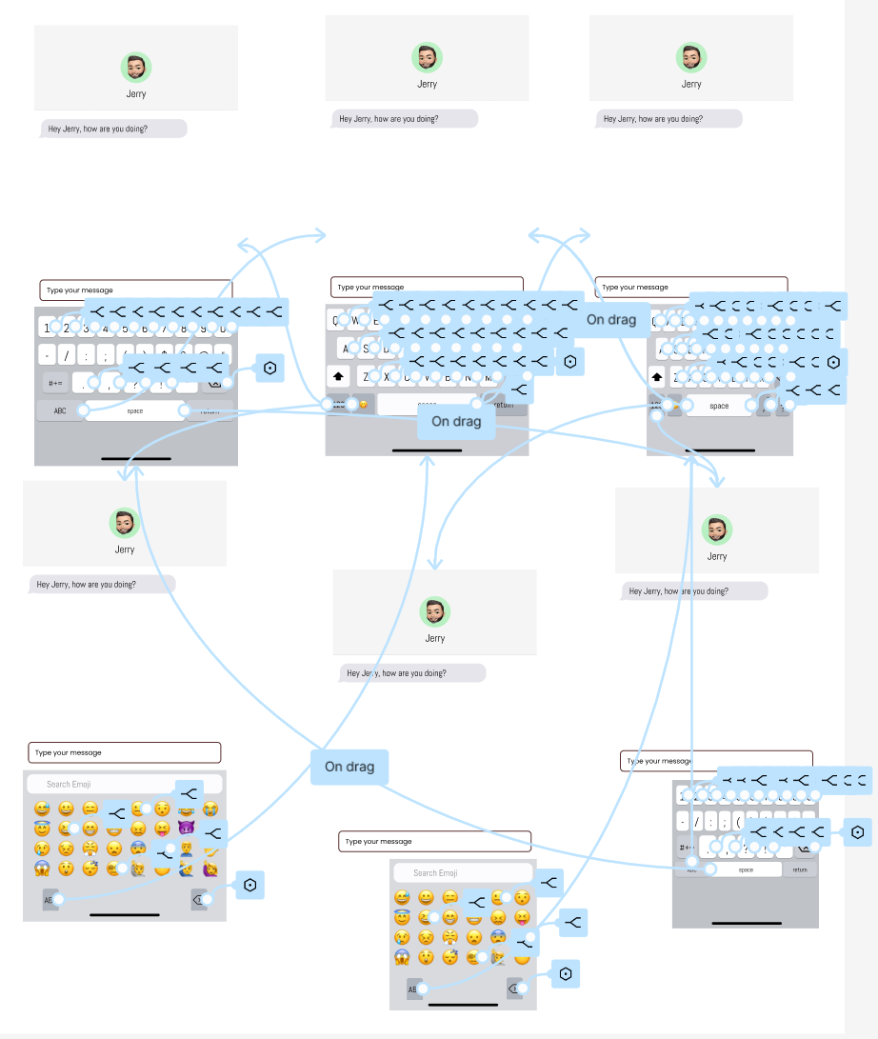
One-Handed Shifted Keyboard
Franklin Kong, Yichen Zhong, Daniel Shim, Zirui Zhao, Isaac Tong
Introduction
Design and Prototypes
Quantitative User Evaluation
Promises:
To understand and improve the user experience of one-handed typing on mobile devices.
Address the lack of comprehensive support for one-handed typing in mobile keyboards.
Obstacles:
Issues with current mobile keyboards, such as accidental touch and missed touch, hindering typing efficiency.
Initial prototype design failed to reduce recognition load, indicating room for improvement.
Solutions:
Conducted surveys and contextual inquiries to identify user requirements for one-handed typing.
Developed a paper prototype with adjusted key width and revised punctuation keyboard and use simplified user testing and heuristic evaluation to evaluate the design.
Implemented a high-fidelity prototype based on the evaluation and did statistical analysis to test our design.
Takeaways:
The high-fidelity prototype showed a decrease in typing time in punctuation and emojis, indicating an improvement in efficiency.
The study's conclusions suggest a positive direction for developing support features that enhance one-handed typing efficiency on mobile devices.
Method
Test our high-fidelity prototype against User Requirement 5
Independent Variable: Keyboard design (both implemented on Figma)
Current keyboard (baseline)
Our keyboard
Dependent Variables:
Time for entering punctuation (s)
Time for entering emojis (s)
Time for entering numbers (s)
Within-subjects study design
Conducted 3 Paired Wilcoxon Tests
Set null hypothesis (H₀) and alternative hypotheses (H_{a})
e.g. H₀ for punctuation: There is no difference between the mean time to enter punctuation on our new keyboard and the mean time to enter punctuation on the original keyboard (while using one hand).
e.g. H_{a} for punctuation: The mean time to enter punctuation on our new keyboard is faster than the mean time to enter punctuation on the original keyboard (while using one hand).
Draw the box plot for each pair of data (our design vs baseline)
Calculate t, p-value, and draw conclusion
Tasks/Procedures
2 Sessions: Session 1 = Practice, Session 2 = Real (used for analysis)
For each session, participants entered one piece of text containing punctuation, emojis, and numbers, respectively, on both keyboard designs
Time for entering each piece of text was recorded
Participants
Performed the experiments on 15 participants
Demographics: Age 20-25, College Students
Habits: iPhone users, Right-handed
Sketches and Storyboards
Current Context of Use
Paper Prototype
Results
Focus:
Mobile text entry with only the right hand preferably on an iPhone, specifically regarding fixing typos, switching between numbers/letters, and switching languages.
Interpretation Themes:
Users make many slips texting one handed
Keyboard layout hinders the user's ability to enter text
Users usually find some assistive keyboard technologies unhelpful
The size and weight of the phone sometimes causes physical discomfort to the user to text with only one hand
Breakdowns Types:
High frequency of typos
Inconvenient keyboard layout
Failure of keyboard assistive features,
Size of the mobile device
Uncomfortable hand postures
p-value: 0.0056
Reject Null Hypothesis
It is significantly faster to enter punctuation on our keyboard than on the existing keyboard, while using one hand.
p-value: 0.0285
Reject Null Hypothesis
It is significantly faster to enter emojis on our keyboard than on the existing keyboard, while using one hand.
p-value: 0.2610
Fail to Reject Null Hypothesis
There is inconclusive evidence to say that it is faster to enter numbers on our keyboard than on the existing keyboard, while using one hand.
Functional Prototype
Takeaways & Future Work
Takeaways
Improve the signifiers of the key features on our keyboard
Redesign the textbox to allow easier access with one hand
Create the shifted keyboard for left handed users
Our keyboard design show increase in speed for punctuations and emojis use
User Requirements
Future Work
Revise our design for the numbers keyboard
Implement more functional features based on user requirements
Create the shifted keyboard for left handed users
User Requirement 2: User should not need to manually fix any results produced by the system’s keyboard assistive features (e.g., autocorrect) when entering text on their mobile device with one hand
User Requirement 3: User should be able to remove any text entered on the mobile device using one hand without accidentally modifying any other characters or words they did not intend
User Requirement 4: User should be able to interact with all keyboard elements using one hand without slips and without straining (overextending) their thumb (hand) or repositioning the mobile device
User Requirement 5: User should be able to locate and enter emojis, punctuations, and numbers on the mobile device with one hand faster than their default (i.e., current or existing) method of entry
References
[1] Jorge J. Nicolau, H. 2012. Touch typing using thumbs: understanding the effect of mobility and hand posture. CHI ’12 (2012). https://doi.org/10.1145/2207676.2208661
[2] Pierre Rimoldi Bixio Tarniceriu, Adrian Dillenbourg. 2012. Single-Handed Typing with Minimal Eye Commitment: A Text-Entry Study. (jan 2012). https://www.researchgate.net/publication/266483153_Single-Handed_Typing_with_Minimal_Eye_Commitment
[3] Kunpeng Zhang and Zhigang Deng. 2022. A Comparative Study on Single-Handed Keyboards on Large-Screen Mobile Devices. In Proceedings of the 2022 International Conference on Advanced Visual Interfaces (Frascati, Rome, Italy) (AVI 2022). Association for Computing Machinery, New York, NY, USA, Article 4, 9 pages. https://doi.org/10.1145/3531073.3531075

